Slide 1



GeoPix: Image-to-Image Translation for Reservoir Characterization
Using Pix2Pix cGANs for Predicting Subsurface Properties
Abdulrahman Al-Fakih
College of Petroleum Engineering and Geosciences,
King Fahd University of Petroleum Minerals, Saudi Arabia
2025

Slide 2
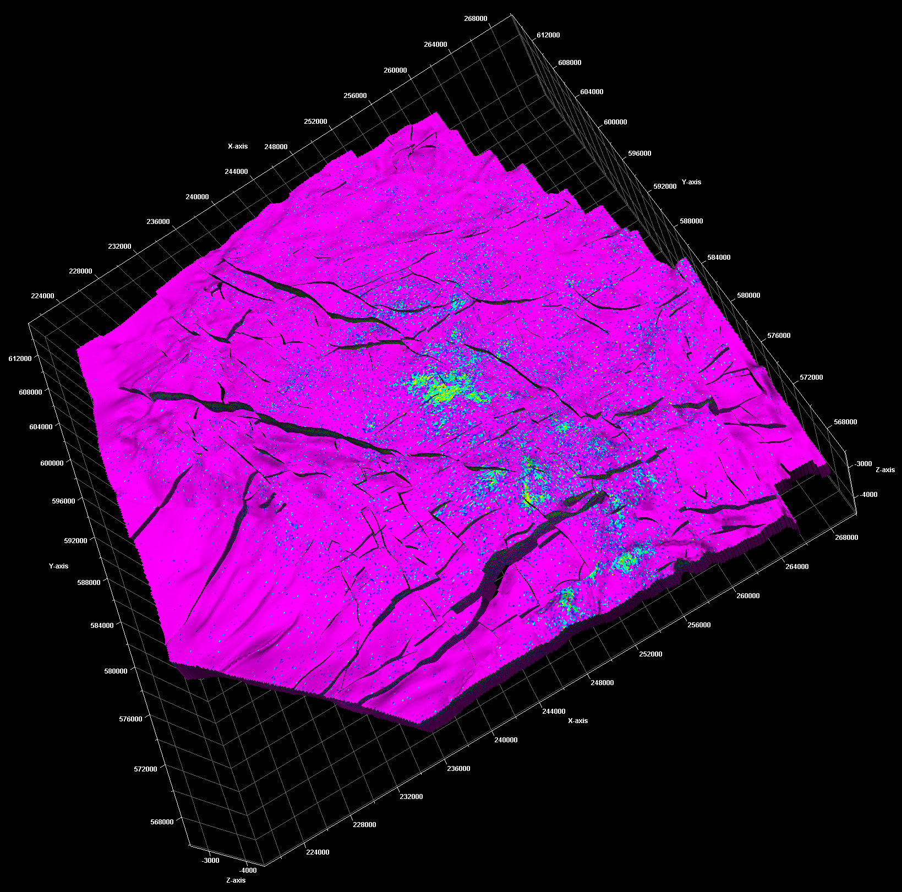
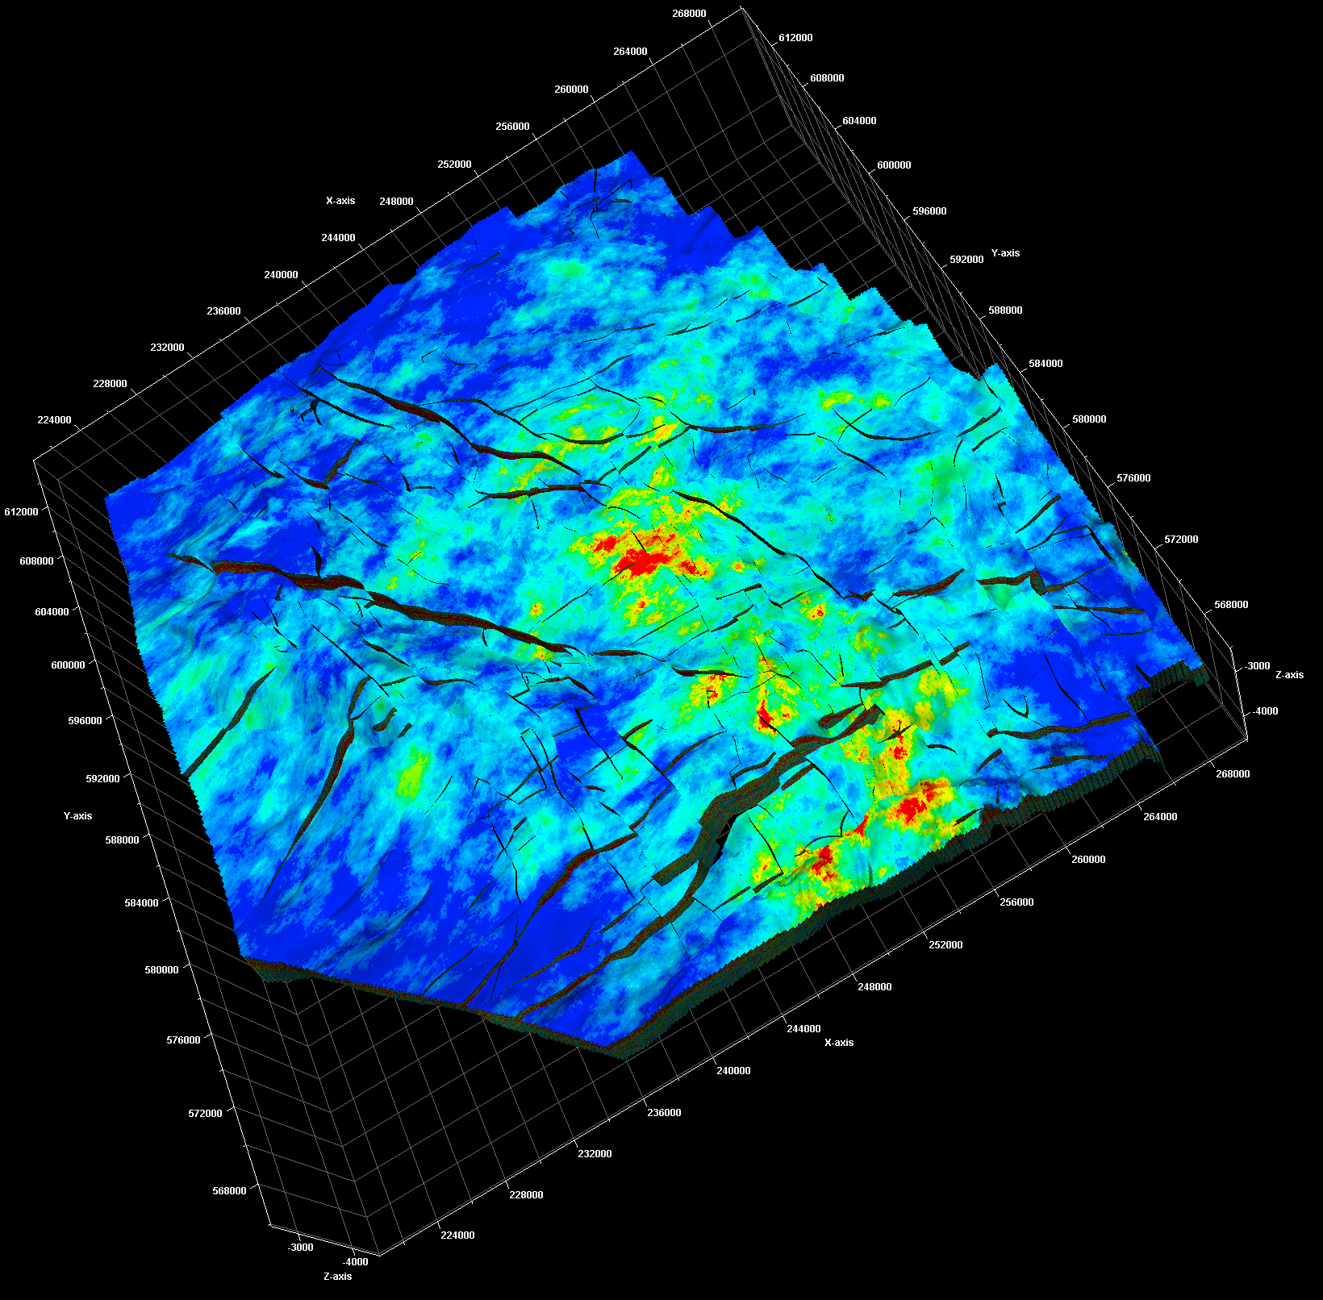
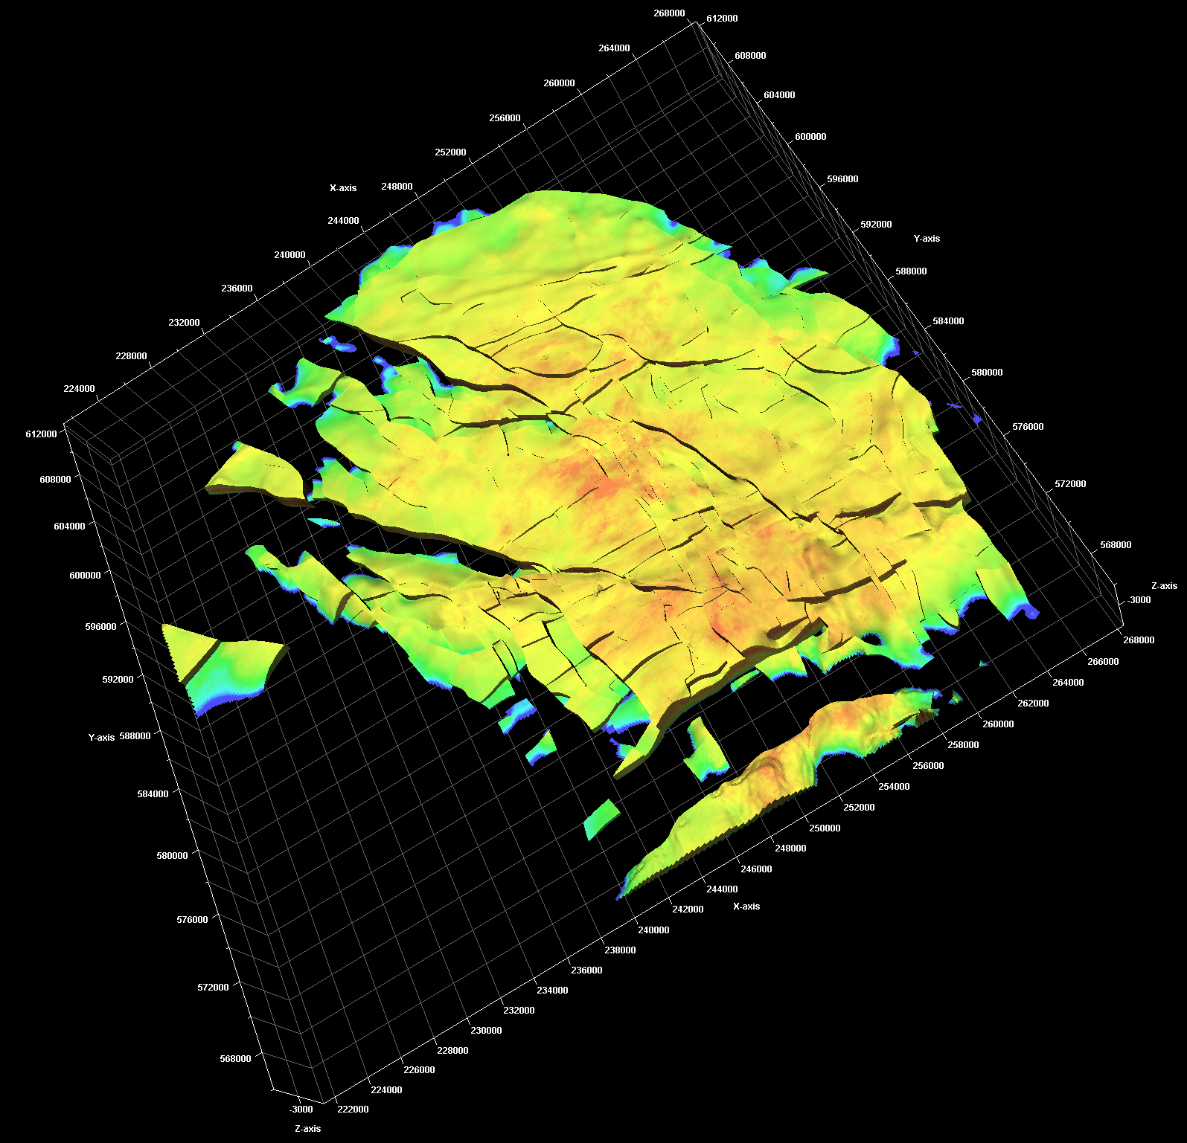
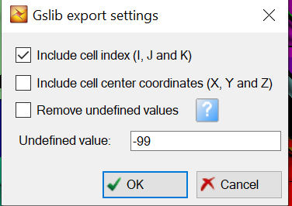
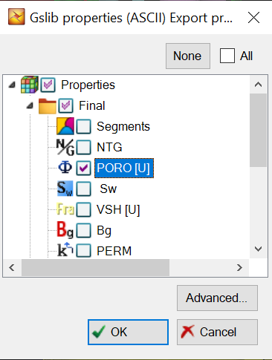
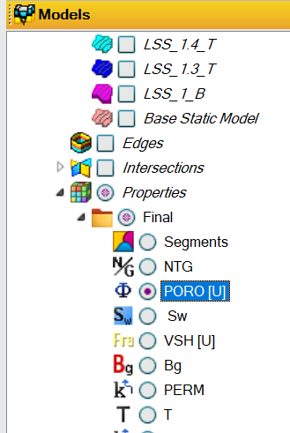
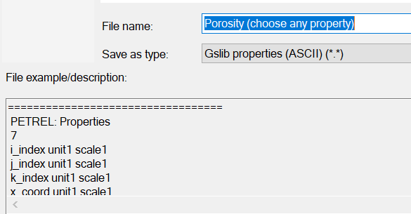
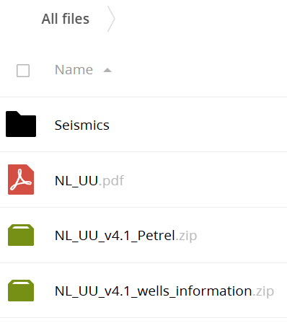
1. Dataset Preparation
Source:
Download the dataset from Yoda Data Repository or SURFsara Repository.
Extract the downloaded Petrel.zip file.
Steps:
Open Petrel:
Locate models such as porosity, permeability, and water saturation under the Models section.
Export Property (e.g., Porosity):
Right-click the property you want to export.
Select: Properties → Export object → Gslib format.
Set Export Options:
Check conceptual models to export.
Go to Advanced settings and ensure “Include cell index” is checked.
Confirm Export:
Click OK to save the file.

Slide 3
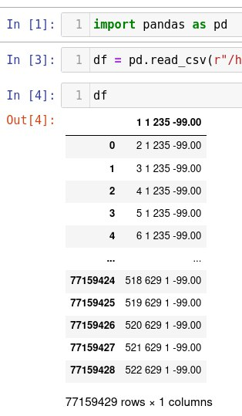
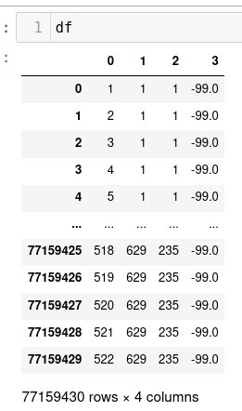
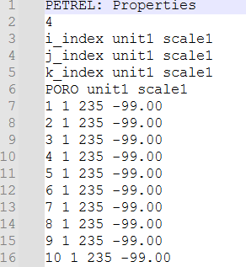
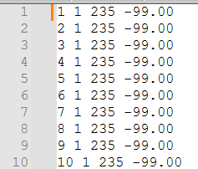
2. Convert exported conceptual model files into text or csv file
Conceptual model files exported from Petrel (Gslib format) are large (with decimals, float format) and not convenient to save, transfer, So you can use notepad++ to open it and check your data → Remove header first six lines → Save file as text or csv file → use (EDA code) to explore the dataset → inverse k values by using :
- By default k values come in inverse, so to solve this issue:
Find the max value in column 3.
Transform column 3: max_value - column_value.
Add 1 to column 3 to shift range from 1 to 235
- Now dataset are ready for extracting layers:
Each property has CSV contains 4 columns.
Facies cube shape: (523, 630, 236)
Use code “0.Krevs, for Petrel data-Porosity”:
Gslib format=1.6 GB
Gslib format without header
Read CSV format
After inverse k

Slide 4
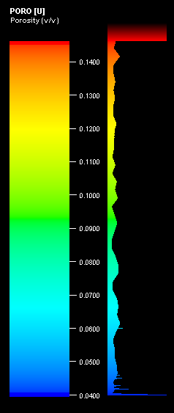
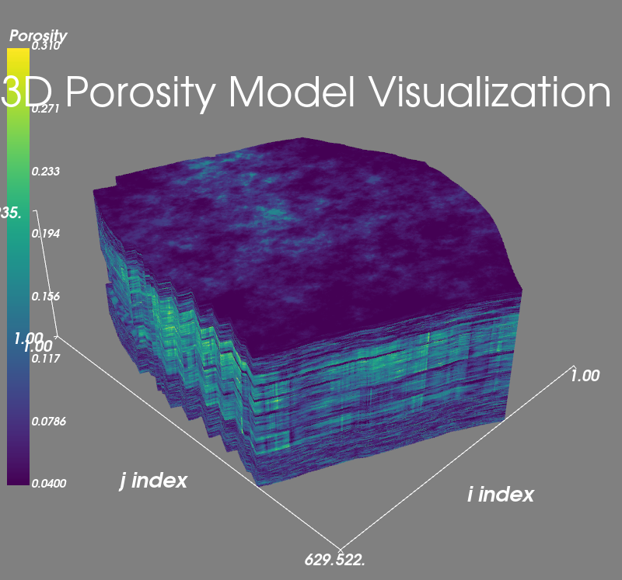
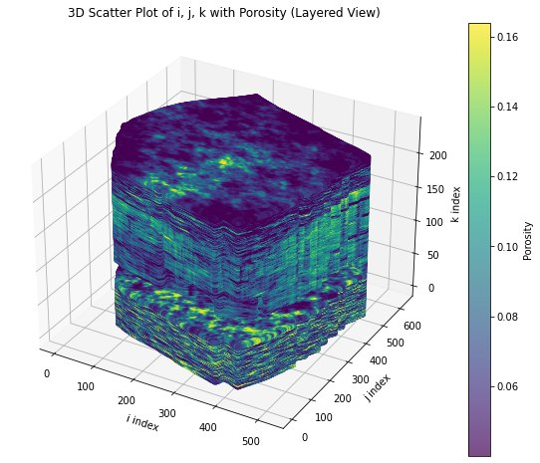
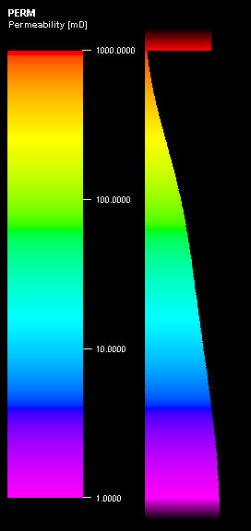
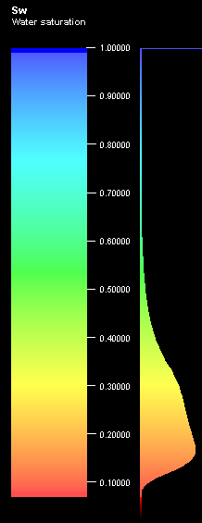
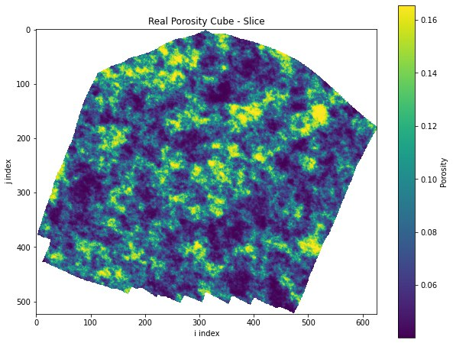
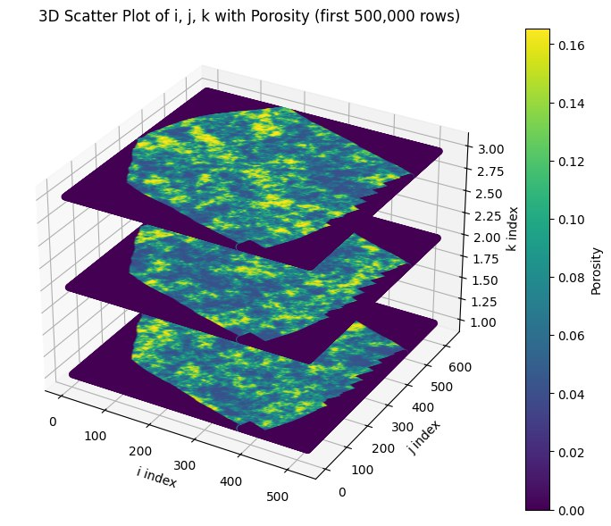
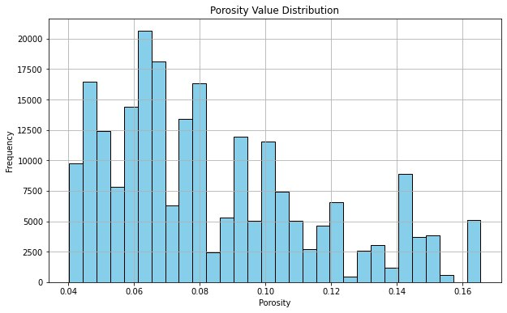
3. Prepare training dataset for GeoPix
Use code “1. Extract orginal ayers for whole model ”:
The code processes property data to create high-resolution images of geological layers:
Load and Clean Data: Reads and preprocesses permeability data from a CSV file.
3D Array: Organizes data into a 3D cube, where each slice represents a geological layer.
Custom Colors: Maps facies types to specific colors. Try to make it similar to Petrel Colum color legend , that what we did.
Image Processing:
Generates high-resolution images of each layer.
Enhances image quality (sharpness, contrast, brightness).
Saves images with white backgrounds for missing values.
5. Output: Saves ultra-high-resolution images in the specified directory for visualization.
Do EDA to explore the data for each layer for each property such as these photos.
Notes:
Channels can not be truncated (corroded) by lobes.

Slide 5
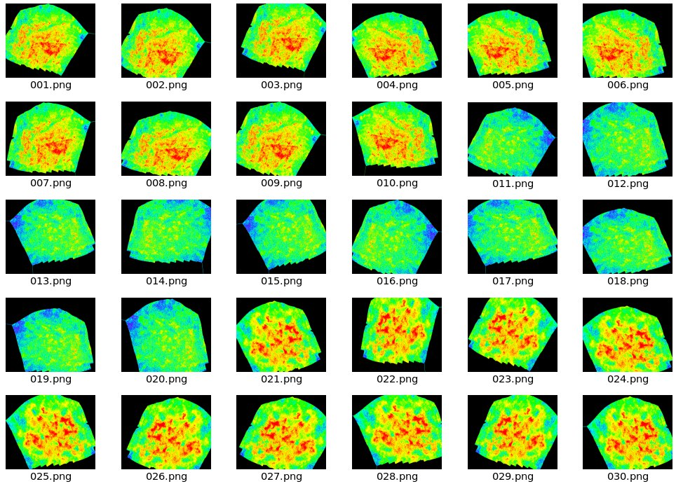
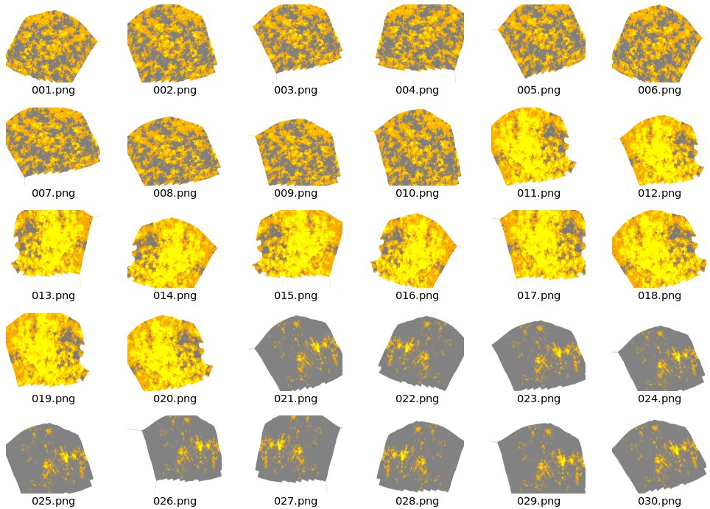
3. Prepare training dataset for GeoPix.....Cont’
Use code “2. High-Resolution Augmentation”
Steps for Facies Image Augmentation
Setup: Define directories for original and augmented images.
Load: Convert images from original_dir to NumPy arrays.
Augment: Apply transformations (rotation, shift, zoom, flip) using ImageDataGenerator.
Save: Generate 10 augmented versions per image and save in augmented_dir.
Combine the real layers with augented
See example of augmented properties
We have 235 layer for each property , we augmented 10 layers for each original layer.

Slide 6
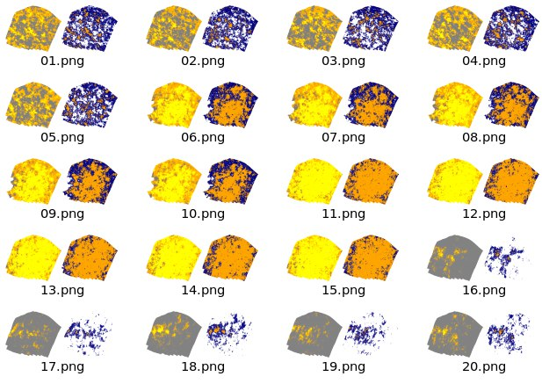
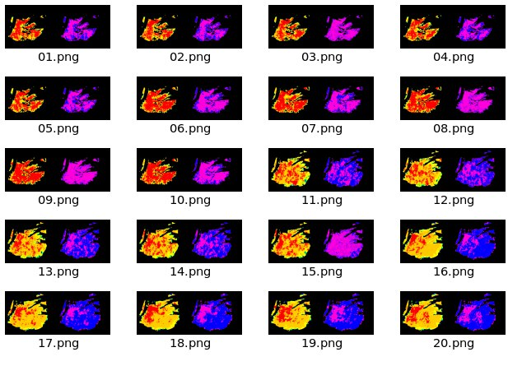
4. Property Mask and Paired Image Creation
User code :”3.Creating a PERM. segmentation masks + Spiliting them for Porosity Data”
Generate Masks: Identify geological features (yellow, orange, gray, blue…ect ) and set background. Here we applied only for masked task.
Create Pairs: Combine original/augmented images with masks side by side. 1. In Masked task: Pairs are mask property + original property. 2. In Image translation task, pairs are Facies+ porosity/permeability / Sw , also you can try vise verse.
Process & Save: Save paired images as PNGs in the output directory.
Visualize: Display a few paired examples for verification.
See some examples

Slide 7
5. Dataset Splitting for Sw Layer
User code :”3.Creating a PERM. segmentation masks + Spiliting them for Porosity Data”
Facies Dataset:
Training Set: 1809 images
Validation Set: 387 images
Testing Set: 389 images
Permeability Dataset:
Training Set: 1809 images
Validation Set: 387 images
Testing Set: 389 images
Porosity Dataset:
Training Set: 1816 images
Validation Set: 389 images
Testing Set: 390 images
Water Saturation (Sw) Dataset:
Training Set: 1694 images
Validation Set: 363 images
Testing Set: 363 images
Directories: Organized train, val, and test folders.
Load Images: Combine and shuffle original and augmented image paths.
Split Ratios: 70% training, 15% validation, 15% testing.
Copy & Rename: Save images in respective folders with sequential numbering.
Summary: Display counts of images in each set.
See each property final spilt no.
Ready for training and evaluation.

Slide 8
Image-to-Image Translation for Subsurface Reservoir Characterization
Task1 :Property Mask Prediction
The model takes masked input images for each property (e.g., porosity, permeability, water saturation) and predicts their corresponding detailed outputs.
Task 2 :Image-to-Image Translation
The model performs direct image translation from facies images to predicted properties such as porosity, permeability, or water saturation.
4. Geo Gan Pix2pix Module

Slide 9
Codes
0.Krevs, for Petrel data-Porosity
1. Extract orginal ayers for whole model
2. High-Resolution Augmentation
3.Creating a PERM. segmentation masks + Spiliting them for Porosity Data
4. Geo Gan Pix2pix Module
Github code repository: https://github.com/ARhaman/GeoPix/tree/main
Dataset: https://zenodo.org/uploads/14603410
Notes:
Channels can not be truncated (corroded) by lobes.

